Slide 1


Science Fair Project
By Your Name
no_reply@example.com

Slide 2
Why we chose this area of science
At first we had a lot of ideas for different projects. Then we evaluate those choices and come up with one.
The goal of this project is to help youths to master STEM subjects in more effective and innovative way.

Slide 3
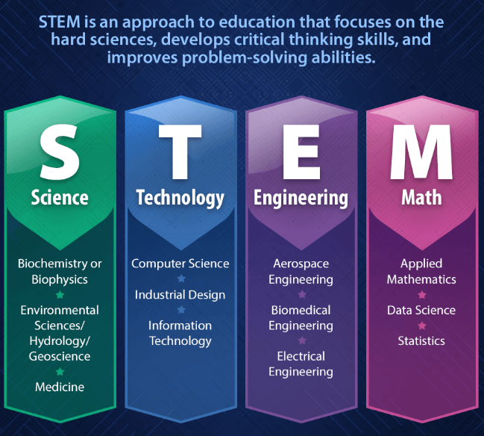
What are the STEM Subjects?

Slide 4
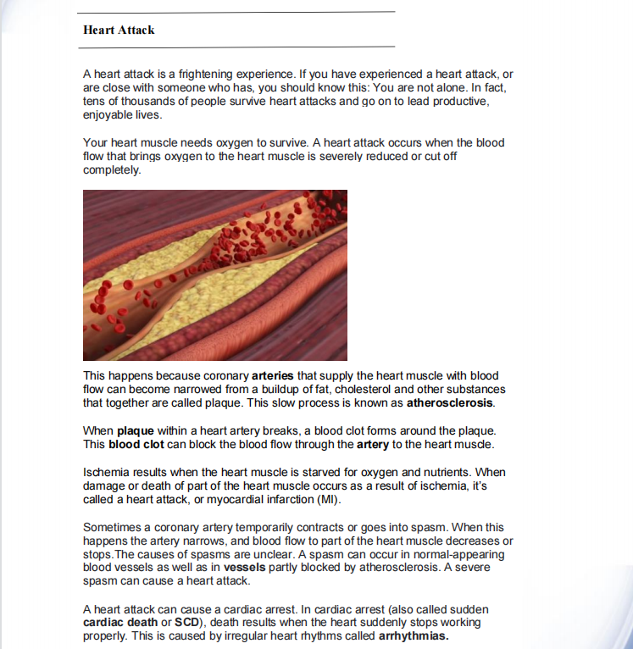
Why they are so hard?
Too many description
Few images on a page
Vague imagination

Slide 5
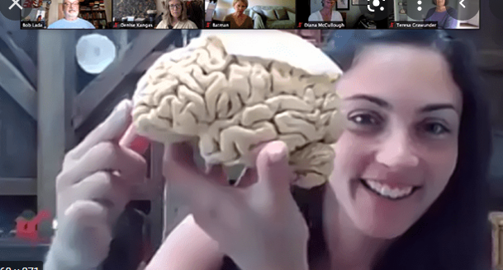
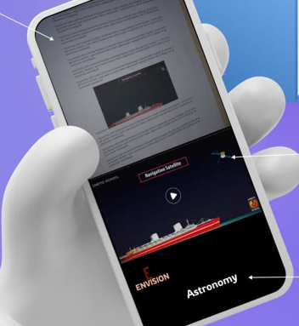
Aha! What we found.
What did we do to tackle the problem, then find the solution?
After investigation we find that human brain can learn more effectively from image and video rather than only text.

Slide 6
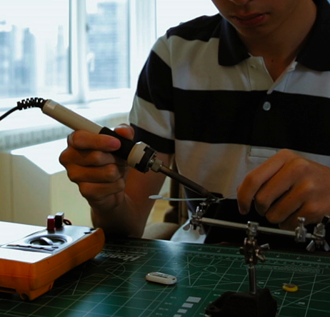
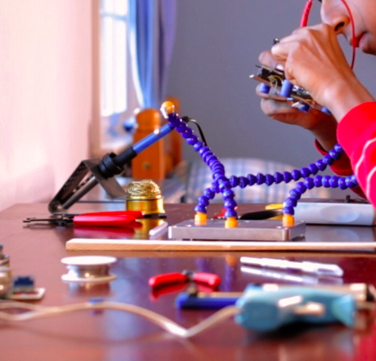

Steps towards solution.
Decided to use Machine Learning
Database(images, videos)
Writing codes
Testing.

Slide 7
Experiment
Data testing
Physics
Engineering
Medicine
Biology
Bio-chem
99
98
96
97
95
Accuracy: 95%
10min
20min
30min
40min
40min

Slide 8
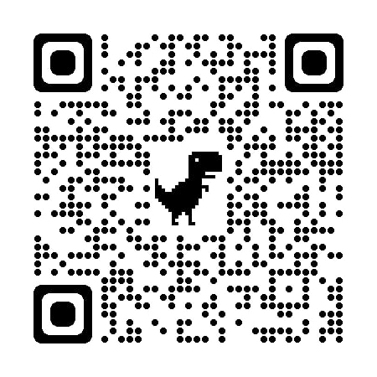

Scan me...
ENVISION

Slide 9
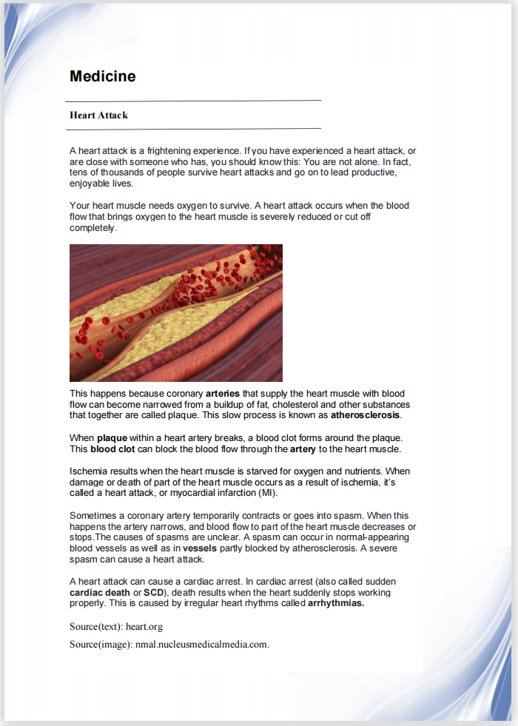
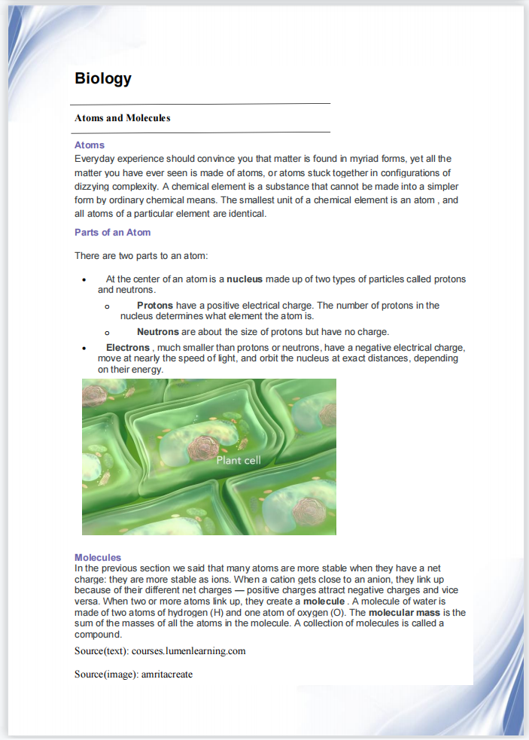
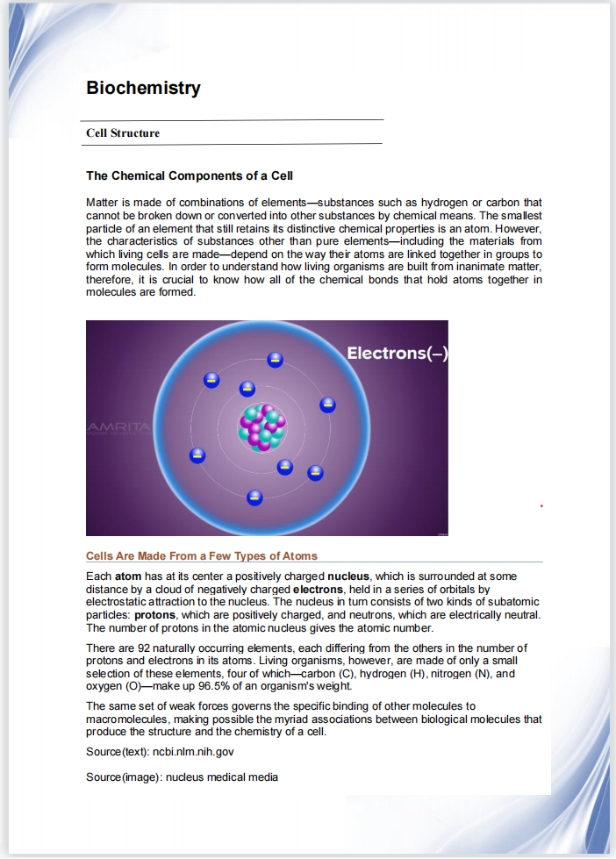
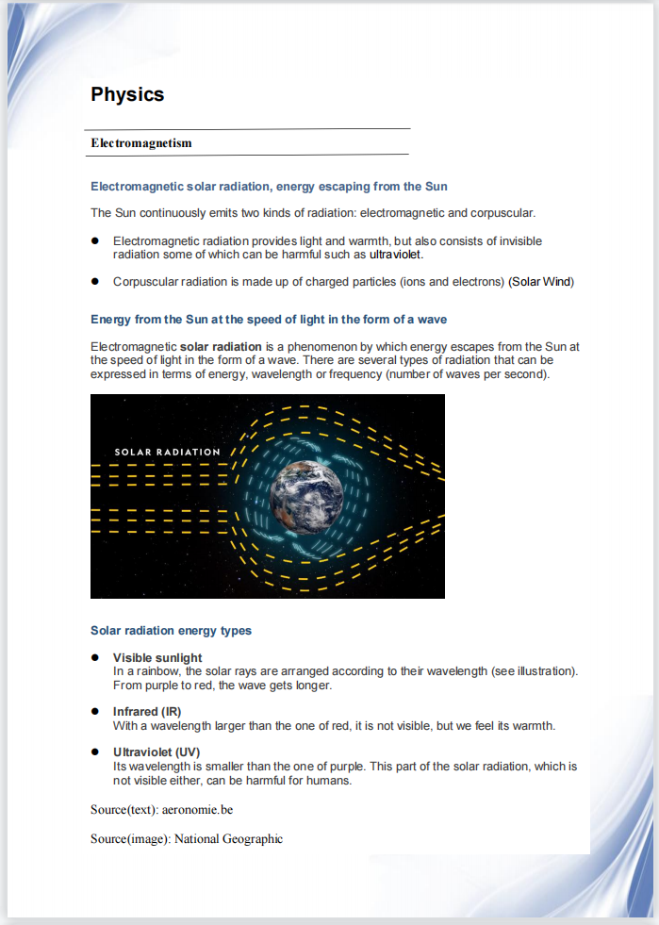
Book pages to test

Slide 10


